Slide 1
Introduction to LLM (Large Language Model) Applications on AMD Platforms
黃彥勲
Sean Huang
Notes:
在AMD平台打造您的大型語言模型(LLM)應用

Slide 2
Lesson Outline
Theoretical Component
Introduction to Function Calling: Overview
Foundations of LLMs
Basics of LLM Fine Tuning
Retrieval-Augmented Generation (RAG)
Function Calling Implementation
Break Time
Practical Component
Porting Nvidia Solutions to ROCm/Ryzen AI
Preparations for Working With LLMs
LLM Deployment Using Transformers
LLM Deployment Alternatives
Fine Tuning with LoRA
Function Calling Using Transformers and Ollama
RAG Using Ollama and LM Studio
Code and lecture slides: https://github.com/jonathansimple/intro-to-llms
Notes:
24.10

Slide 3
Overview
Introduction
This course serves as an introductory guide for those interested in deploying LLM solutions on ROCm. It covers a high level discussion on the foundation of LLMs and includes practical implementations attendees can follow along.
Target Audience
Programmers familiar with Python
Computer Science or Electrical Engineering students interested in building LLM solutions on ROCm
Anyone looking to build their first LLM project
Developers looking to migrate CUDA solutions to AMD platforms
Resources
Code and lecture slides: https://github.com/jonathansimple/intro-to-llms
Notes:
Beginner friendly course

Slide 4
Goals
Two primary goals:
We want to instruct a LLM to interact with external APIs to perform a task for us (via function calling)
We want to update a LLM's existing knowledge with and without using fine tuning
As you will find out, there are many ways to do this
To accomplish this, we will be discussing a series of LLM related concepts and tools
To understand why we need to cover these topics, the first step is to understand what function calling is

Slide 5
Introduction to Function Calling: Overview

Slide 6
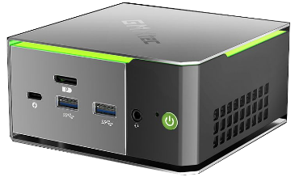

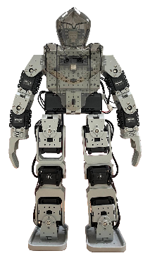

Tools/Function Calling
Objective: using the semantic understanding of large language models (LLMs), convert a user’s unstructured command into control signals for other applications with function calling
For LLMs, function calling refers to when the LLM infers the correct function to call and its input parameters from the user prompt
Applications: IoT, search (retrieve real-time data online or from local database), automated customer service (banking, booking), AI PC
Take two steps forward
[00 01 11 00]
Controller
Whisper
Gemma 2 2B
API
Speech to text
Decide which function to use and convert text to JSON
Using JSON data fields as input, call function
Spoken command as input
{“function”: “perform_action”, “action”: “walk forward, …”}
Perform action

Slide 7
Essential Components of Function Calling
Model: does the model support function calling?
Prompt: do the function descriptions describe the task clearly? Is the prompt clear?
External API: does the application have API support?

Slide 8
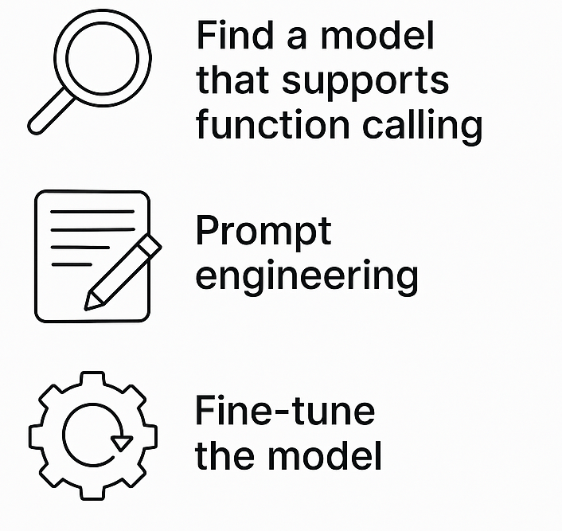
What Happens If You Lack the Essential Components?
Model: the model does not support function calling
GPT, mistral, deepseek, breeze, phi, gemma
(If model has good comprehension) Adjust function descriptions, provide examples for few shot learning
Train the model on public/custom function calling datasets*
Notes:
You can do anything you want if you fine tune the model

Slide 9
What Happens If You Lack the Essential Components?
Prompt: if the model supports function calling/has good text comprehension, how can you improve function calling performance in the following cases?
Function output format is incorrect
Few shot learning, use special tokens (<functional>, etc.)
Some functions are not getting called/called more than others
Check max input size, make sure there isn’t too much overlap between functions
The model only outputs formatted text and lost the ability to chat normally
Adjust system prompt to instruct model to only use function call when applicable, consider using multi-agent systems (one for parsing functions, another for chatting)

Slide 10
What Happens If You Lack the Essential Components?
External API: does the application have official API support?
Yes
Then there’s no problem, just pick out the functions you need and determine what parameters to parse as inputs
No
Hack the application and write your own API
Find alternative applications

Slide 11
Foundations of LLMs

Slide 12
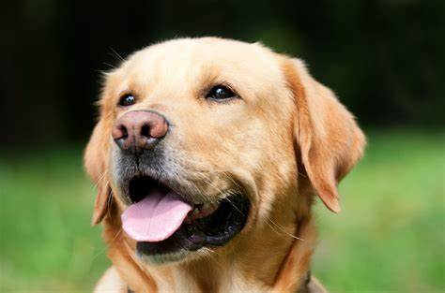

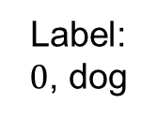



Comparison With CNN
CNN steps: convert image to matrix → inference → f(output)
Function f can be argmax for classification, for example
LLM steps: tokenize (string to token) → inference (generate) → decode (token to string)
Tokenization example:
"ChatGPT is amazing!" → ['Chat', 'G', 'PT', ' is', ' amazing', '!’] → [12345, 678, 91011, 314, 56789, 42]
cv2
$$\left[\begin{matrix}1 & 2 & 3 \\ 4 & 5 & 6 \\ 7 & 8 & 9\end{matrix}\right]$$
matmul
CNN
argmax
$$\left[\begin{matrix}1 & 2 & 3 \\ 4 & 5 & 6 \\ 7 & 8 & 9\end{matrix}\right]$$
Label: $0$, dog
$$\left[\begin{matrix}1 & 2 & 3 \\ 4 & 5 & 6 \\ 7 & 8 & 9\end{matrix}\right]$$
$$\left[\begin{matrix}1 & … & 0\end{matrix}\right]$$
Image
augmentation
tokenize
matmul
LLM
decode
“How are you?”
$$\left[\begin{matrix}1 & … & eos\end{matrix}\right]$$
$$\left[\begin{matrix}8 & … & eos\end{matrix}\right]$$
“I’m doing great”

Slide 13
Background For LLMs: Tokenizer
What are tokens?
LLMs need tokenizers to convert strings into tokens (numerical IDs) that the model can understand
Working with numerical values (float/int) is easier than strings
Every model has their own tokenizer
To better generalize unseen vocabulary during training, words are broken down into smaller parts (so one word can be more than one token)
Word seen during training: “unavailable”
“un” → 42
“avail” → 189
“able” → 76
New unknown word seen during inference: “unimaginable”
“un” → 42
“imagine” → ?
“able” → 76
Token 42 = not/opposite
Token 76 = can
So “unimaginable” should have a meaning related to being unable to do something
Notes:
Tokenizer set during training; if you use a tokenizer for one model on a different model, the output will break

Slide 14
What LLMs Are Out There?
GPT, Deepseek, Llama, gemma, Taide, Breeze, Mistral, Internvl, Qwen…
Each model has their own strengths and weaknesses:
GPT: most well rounded option out there, but not open source and not commercially hostable
Breeze: has Traditional Chinese support + open source + commercially viable (3B, 8B); output can be a bit verbose
More and more recent models are capable of function calling – it’s all about picking what suits your use case best (model size, multi-lingual support, etc.)
Newer models have better text comprehension and some models that weren’t trained to do function calling can still perform basic FC if taught in prompts
Why do we need fine tuning then?
Stability, formatting, some smaller models really don’t have one-shot learning capability because they can’t generalize well enough

Slide 15
Basics of LLM Fine Tuning

Slide 16
Fine Tuning Methods
Most common methods:
Full fine tuning
LoRA

Slide 17


Full Fine Tuning
Like the name suggests, this updates all model parameters during training
Pros:
Cons:
Best performance when trying to train a model for a specific task
Modifies core model behavior (reasoning, output format)
Used to create foundational models
Very demanding resource wise (time, VRAM, checkpoint storage, data required)
Easy to overfit on small datasets and forget old skills

Slide 18
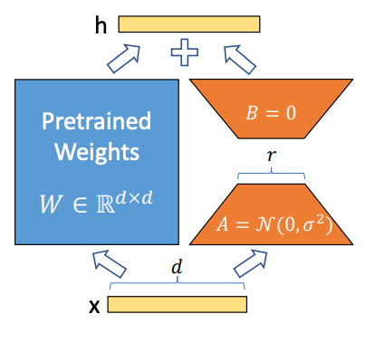
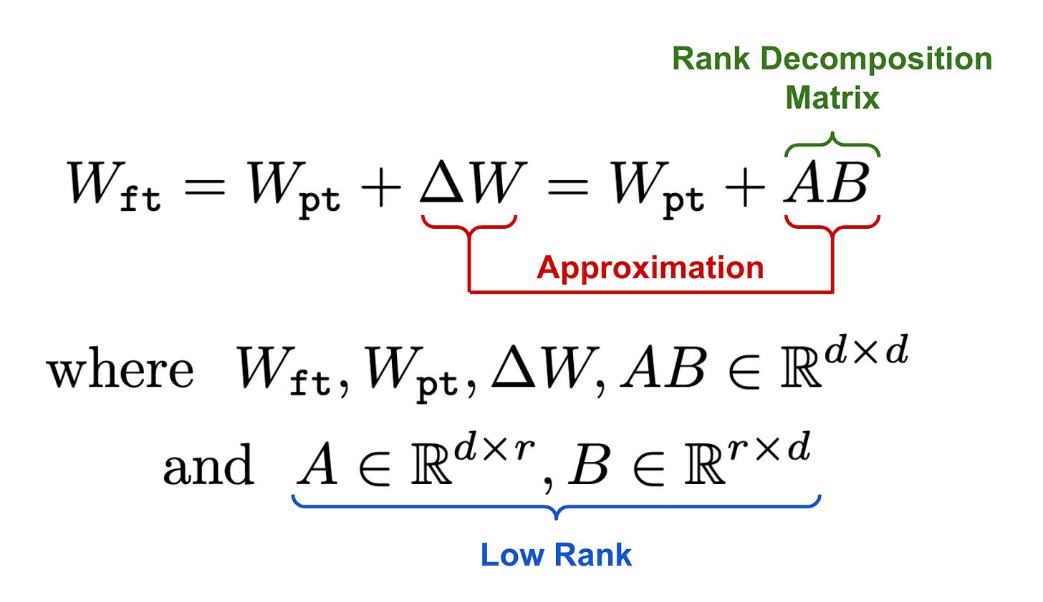
Low-Rank Adaptation (LoRA)
How It Works:
Freeze the pre-trained LLM weights.
Add small trainable low-rank matrices (A & B) to attention layers.
Train only these new matrices, keeping the original model intact.
The trainable weights are then merged with the base model.
Notes:
initialize A with random, small values, while B is initialized as zero, ensuring that we begin the finetuning process with the model’s original, pretrained weights

Slide 19
Low-Rank Adaptation (LoRA)
Key Benefits:
✅ Reduces Memory Usage – Fine-tunes only a small fraction of the model parameters. ✅ Faster Training – Requires fewer computations, making it cost-efficient. ✅ Retains Pre-Trained Knowledge – Keeps most of the original model weights frozen. ✅ Easier Adaptation – Fine-tune large models (e.g., LLaMA, Mistral) on consumer GPUs. ✅ No Added Inference Latency – doesn’t slow down model.
Use Cases:
Fine-tuning LLMs on domain-specific data (e.g., medical, legal, finance) and special formatting
Fine tuning on limited hardware
When you only want to partially modify model performance while maintaining core behavior

Slide 20
Retrieval-Augmented Generation (RAG)

Slide 21
What Is RAG (Retrieval-Augmented Generation)?
Problem: LLMs like GPT are trained on massive datasets, but they:
Can hallucinate (make up facts)
Do not have any knowledge of current events after their training cutoff date
Can’t access private or custom data during pretraining
For smaller models, they lack domain specific expertise
Solution: RAG
Step 1: Retrieve relevant documents from an external database (e.g., PDFs, websites)
Step 2: Generate an answer using both the user question and the retrieved content
This makes responses:
✅ More accurate
✅ More up-to-date
✅ Customizable to your domain
All without fine-tuning!

Slide 22
RAG Encoder
How does the retrieval system know which documents are relevant?
With RAG, you are working (generally) with 2 models
LLM model (generator) that answers your questions
Embedding model (encoder) that maps your question into the same vector space as your dataset (vector store)
The vector store finds the most similar documents (top-k) to the query vector (cosine similarity)

Slide 23
An Example RAG Framework
Query
Output
……
LLM
……
Top k most relevant context (cosine)
encoder
----------
----------
----------
encoder
(offline)
Reference documents
Vector database

Slide 24
RAG At Work
If you use an older model like gemma-2-2b-it and ask it:
Do you have any information on who the president of the United States is in 2025?
It will respond with:
I do not have access to real-time information, including future events. Therefore, I cannot tell you who the President of the United States will be in 2025.
With RAG:
According to the news sources you provided, the President of the United States in 2025 would be **Donald Trump**.

Slide 25
When to Use RAG?
Most tasks can be accomplished with RAG (without fine tuning the model)
To draw a parallel with CNNs, RAG is similar to using data augmentation (prompt engineering) and few shot learning to circumvent fine tuning
Applications:
Domain specific QA: customer service, automatic inspection
Personalized service: can't be expected to load entire chat history or fine tune model for every user
Cheaply update model while maintaining model's core behavior

Slide 26
Function/Tool Calling: Using Natural Language to Interface with External APIs

Slide 27
Tools/Function Calling
Objective: using the semantic understanding of large language models (LLMs), convert a user’s unstructured command into control signals for other applications with function calling
For LLMs, function calling refers to when the LLM infers the correct function to call and its input parameters from the user prompt
Applications: IoT, search (retrieve real-time data online or from local database), automated customer service (banking, booking), AI PC
Take two steps forward
[00 01 11 00]
Controller
Whisper
Gemma 2 2B
API
Speech to text
Decide which function to use and convert text to JSON
Using JSON data fields as input, call function
Spoken command as input
{“function”: “perform_action”, “action”: “walk forward, …”}
Perform action

Slide 28
Our Model Can Call Functions, Now What?
✅ Model: does the model support function calling?
❓️ Prompt: do the function descriptions describe the task clearly? Is the prompt clear?
❓️ External API: does the application have API support?
Before we craft our prompt, we need to know what task we are performing.

Slide 29
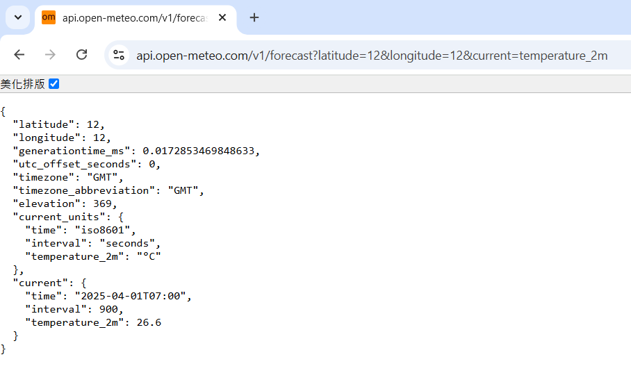
Our Model Can Call Functions, Now What?
Decide on which API you are using:
Example: Open-Meteo (free open source weather
forecast API)
Pick out the functions you will use:
Example: get_weather(latitude, longitude)
Input: (12, 12)
Output: json with current time and temperature
API supports other functions like wind speed,
hourly temperature, etc.
Next step: crafting functions/tools for LLM to use (description + prompts = use these APIs)
Open-Meteo’s API returns an easily parsed json
Notes:
latitude

Slide 30
Function Calling Prompt Crafting
A prompt for function calling contains the following:
General direction/role assignment
Function list
Function name
Description
Function parameter names
Function parameter descriptions
Required inputs
(Optional) Desired output format

Slide 31
Function Calling Prompt Crafting
General direction/role assignment
Example: “You are a helpful assistant with access to the following functions. Use them if required - ”
Assigning a role to a LLM can influence its output:
This affects tonal style, how strict/loose the model should be when deciding whether it should use functions or chat normally
Example: “You are a reliable, trustworthy expert on semiconductor manufacturing. You can answer anything related to your domain of expertise but you must decline to answer when asked about other topics. When applicable, use the functions provided below to help answer the query:”

Slide 32
Function Calling Prompt Crafting
Function list: a function list includes all of the functions you want the LLM to be able to call
You can think of this as a header file for the LLM
Comments are IMPORTANT

Slide 33
Function Calling Prompt Crafting
A single function in the list will have these parameters:
Function name: name of the function
Description: what the function does, when it should be used, how it should be used; as a rule of thumb, if an intern can’t tell how this function works, the LLM won’t be able to either
Function parameter names: the names of the inputs to the function
Function parameter descriptions: function input properties (bool, enum), can include textual description for complex use cases
Required inputs: which inputs must be included
Function output is not explicitly written in the parameters (but usually included in function description)
This is because the LLM’s job is to turn natural language into f(x), the API is what handles the output generation

Slide 34
Function Calling Prompt Crafting
Function declaration example:
Function name: get_weather
Description: Get the current temperature for the provided coordinates in Celsius.
Function parameter names: latitude, longitude
Function parameter descriptions: {"type": "number"} (additional comments and enumerator rule not needed)
Required inputs: latitude, longitude

Slide 35
Function Calling Prompt Crafting
Desired output format:
Some LLMs are already trained on function calling datasets and can output structured data
Sometimes, it can still be useful to specify a particular output format to improve stability
Recommended ways to format outputs:
Json
Token delimiters
Example:
If a function should be used, respond with the function name and its parameters in json format like so:
{"name": "function_name", "arguments": {"arg_1": "value_1", "arg_2": "value_2", ...}}

Slide 36
Putting Everything Together
You are a helpful assistant with access to the following functions. Use them if required -
{
"name": "get_weather",
"description": "Get the current temperature for the provided coordinates in Celsius.",
"parameters": {
"type": "object",
"properties": {
"latitude": {"type": "number"},
"longitude": {"type": "number"}
},
"required": ["latitude", "longitude"]
}
}
If a function should be used, respond with the function name and its parameters in json format like so:
{"name": "function_name", "arguments": {"arg_1": "value_1", "arg_2": "value_2", ...}}
User Query:

Slide 37
A More Complex Example
You are a helpful assistant with access to the following functions. Use them if required -
{
"name": "get_action_set",
"description": "Get the series of actions and the number of times each action needs to be performed in order",
"parameters": {
"type": "object",
"properties": {
"actions": {
"type": "array",
"description": "The actions that need to be performed in the order that is specified by the user. If an action has to be performed multiple times, then repeat the action entry for the same number specified by the user, e.g. "Take two steps forward" would turn into ["walk forward", "walk forward"]." ,
"items": {
"type": "string",
"enum": ["bow", "cheer", "scratch head", "handstand", "sit", "stand", "stabilize", "walk forward", "walk backward", "walk left", "walk right", "turn right", "turn left"],
}
},
},
"required": ["actions"]
}
}
If a function should be used, respond with the function name and its parameters in json format like so:
{"name": "function_name", "arguments": {"arg_1": "value_1", "arg_2": "value_2", ...}}
User Query:
Descriptions are useful when the parameter has special rules or is unintuitive (generally good to have regardless)
Enums are useful when you only expect a fixed set of values in the field

Slide 38
We Have Our Model and Prompt, Now What?
✅ Model: does the model support function calling?
✅ Prompt: do the function descriptions describe the task clearly? Is the prompt clear?
❓️ External API: does the application have API support?
The easy part. Integrate the LLM pipeline with your chosen API

Slide 39
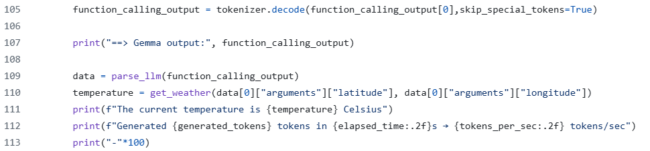
System Integration
Prepare your API calls to take in the inputs you specified
Prepare the API functions you require
LLM output
API call using LLM output as parameters
Don’t worry about the other arcane code, we’ll cover everything here in the practical section

Slide 40
Break Time
Q&A
Session resumes in 10 minutes
Practical portion next:
Code walkthrough + demos
Feel free to clone the repo for code we’ll be going through. If you are setting up a fresh environment, it may take more time than the break would allow. If you already have a working environment with GPU acceleration (CUDA or ROCm), you can follow along by running the code on your own machine
Github link: https://github.com/jonathansimple/intro-to-llms

Slide 41
Porting Nvidia Solutions to ROCm/Ryzen AI

Slide 42
AMD Hardware and Driver Support
Two types of AMD hardware:
AI PCs (laptops) - Ryzen AI 300-series PCs with iGPU + NPU
Desktops – GPUs like RX 6800 and W6800 and up
What’s the difference?
Different hardware require different drivers:
AI PCs: NPU drivers + Ryzen AI Software
Desktops: ROCm (Linux), HIP SDK* (Windows)
*HIP (Heterogeneous-computing Interface for Portability) SDK for Windows brings a subset of the ROCm platform to Windows
Notes:
https://github.com/amd/RyzenAI-SW/blob/main/example/llm/lemonade/cpu/Llama_3_2_1B_Instruct.md
NPU drivers: https://ryzenai.docs.amd.com/en/latest/inst.html#install-npu-drivers
Rocm link: https://rocm.docs.amd.com/projects/install-on-linux/en/latest/install/quick-start.html
Windows rocm compatibility: https://rocm.docs.amd.com/projects/install-on-windows/en/latest/reference/system-requirements.html
Windows installation: https://rocm.docs.amd.com/projects/install-on-windows/en/latest/index.html#hip-install-quick

Slide 43
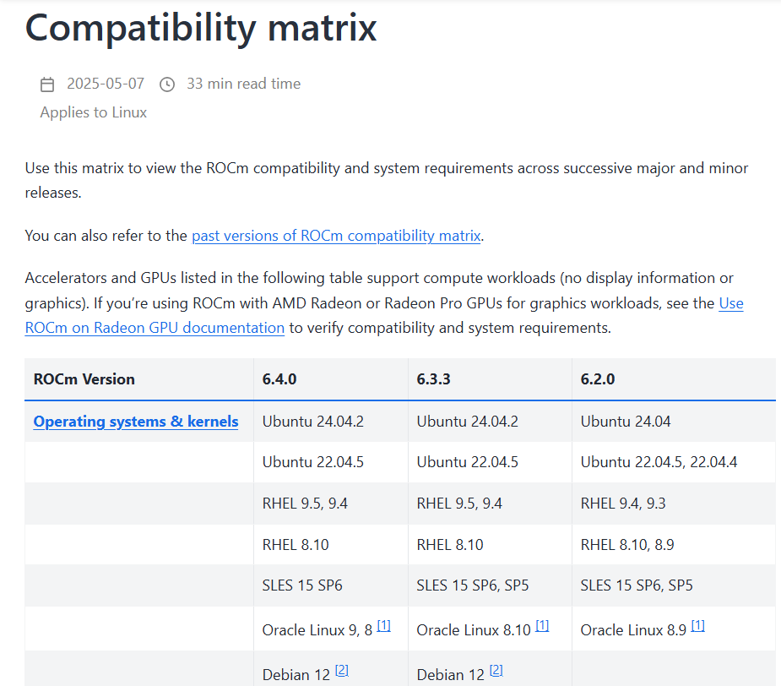
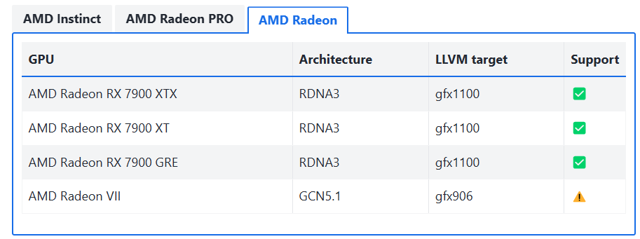
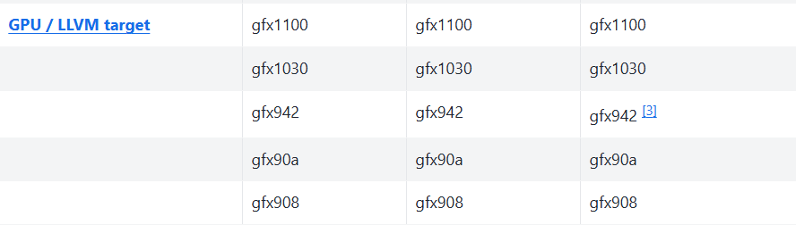
Determining Which ROCm Version Is For You
1.
Short answer: depends on your hardware
1. For the full compatibility matrix, visit: https://rocm.docs.amd.com/en/latest/compatibility/compatibility-matrix.html
2. For which AMD GPUs supports which LLVM target, visit: https://rocm.docs.amd.com/projects/install-on-linux/en/latest/reference/system-requirements.html
2.

Slide 44
ROCm Installation (Ubuntu 24.04)
Install ROCm
wget https://repo.radeon.com/amdgpu-install/6.4/ubuntu/noble/amdgpu-install_6.4.60400-1_all.deb
sudo apt install ./amdgpu-install_6.4.60400-1_all.deb
sudo apt update
sudo apt install python3-setuptools python3-wheel
sudo usermod -a -G render,video $LOGNAME # Add the current user to the render and video groups
sudo apt install rocm
Install AMD GPU drivers
wget https://repo.radeon.com/amdgpu-install/6.4/ubuntu/noble/amdgpu-install_6.4.60400-1_all.deb
sudo apt install ./amdgpu-install_6.4.60400-1_all.deb
sudo apt update
sudo apt install "linux-headers-$(uname -r)" "linux-modules-extra-$(uname -r)"
sudo apt install amdgpu-dkms
Information from:
https://rocm.docs.amd.com/projects/install-on-linux/en/latest/install/quick-start.html

Slide 45
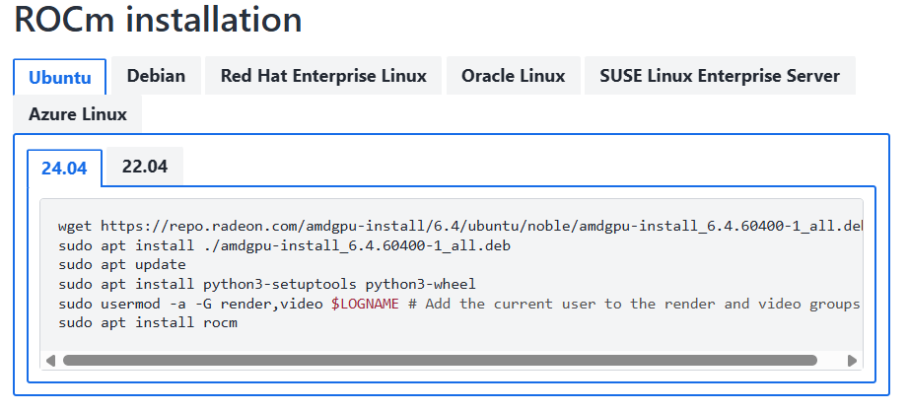
ROCm Installation for Different Distributions
Information from:
https://rocm.docs.amd.com/projects/install-on-linux/en/latest/install/quick-start.html

Slide 46
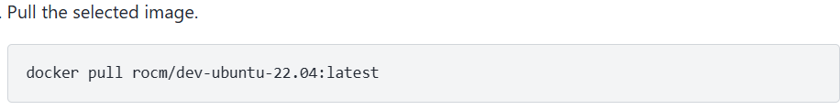
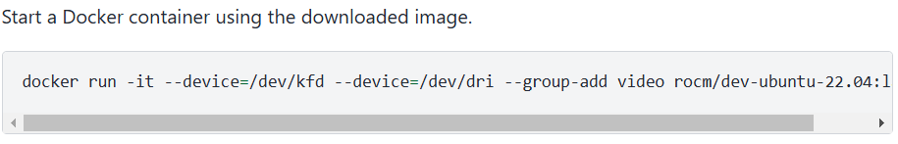
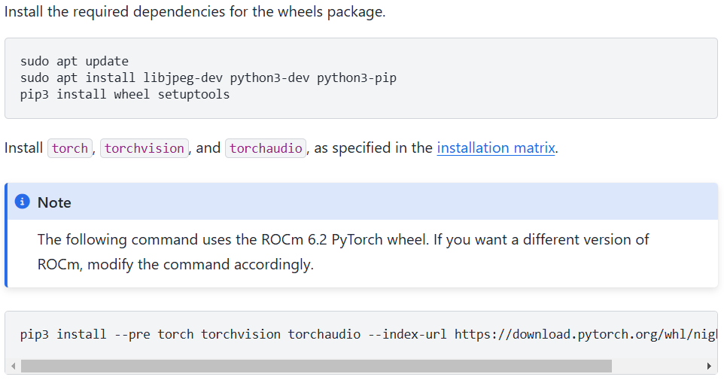
ROCm Pytorch Setup (Ubuntu 22.04)
Screenshots from: https://rocm.docs.amd.com/projects/install-on-linux/en/latest/install/3rd-party/pytorch-install.html
Python 3.10
--index-url https://download.pytorch.org/whl/nightly/rocm6.2/

Slide 47
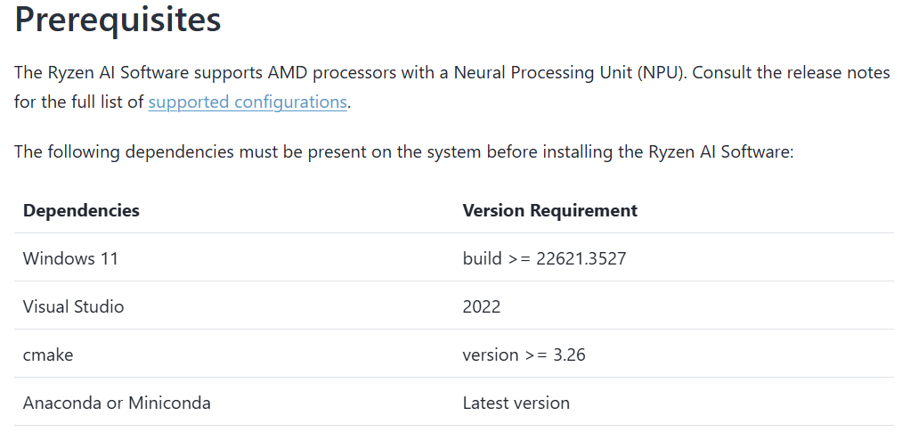
AI PC NPU Driver Installation (Windows)
Go to: https://ryzenai.docs.amd.com/en/latest/inst.html#install-npu-drivers
Ensure your system has the prerequisites installed
Notes:
https://ryzenai.docs.amd.com/en/latest/inst.html#install-npu-drivers

Slide 48
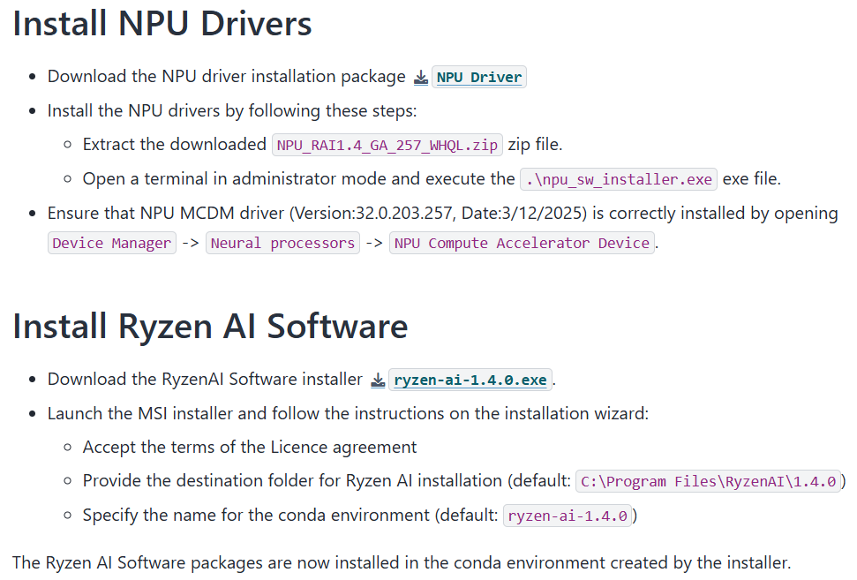
AI PC NPU Driver Installation (Windows)
Create an AMD account and download + run the installers (free)
Notes:
https://ryzenai.docs.amd.com/en/latest/inst.html#install-npu-drivers
Sample demo: https://github.com/amd/RyzenAI-SW/blob/main/example/llm/lemonade/hybrid/Llama_3_2_1B_Instruct.md

Slide 49
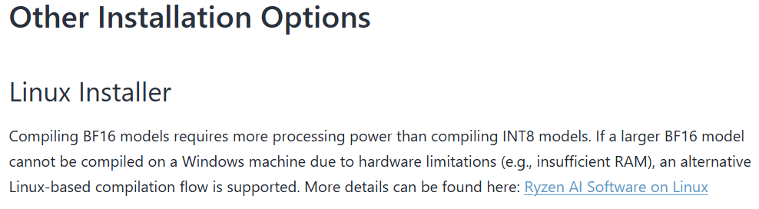
AI PC NPU Driver Installation (Linux)
A Linux installer can be found at the bottom of https://ryzenai.docs.amd.com/en/latest/inst.html
Notes:
https://ryzenai.docs.amd.com/en/latest/inst.html#install-npu-drivers
Sample demo: https://github.com/amd/RyzenAI-SW/blob/main/example/llm/lemonade/hybrid/Llama_3_2_1B_Instruct.md

Slide 50
Porting Nvidia-Based Solutions to ROCm
No code change needed
The only difference between a CUDA and a ROCm project is in its environment setup
Specifying devices:
CPU: “cpu”
GPU: “cuda”
Device is specified using the same method: “0”, “0,1”, etc.

Slide 51
Porting Nvidia-Based Solutions to AI PCs
Minor code change needed
AI PCs rely on the onnx runtime to enable NPU acceleration, without it, speedup is limited
Projects with CPU-only fallback solutions do not need to be modified
When setting up this environment, I strongly recommend following AMD’s Ryzen AI Software + NPU driver installation (the Ryzen AI Software installer will set up a compatible conda environment for you)
Refer to this for an example of running onnx LLMs: https://github.com/amd/RyzenAI-SW/blob/main/example/llm/lemonade/hybrid/Llama_3_2_1B_Instruct.md

Slide 52
Practical Component: Preparations for Working With LLMs

Slide 53
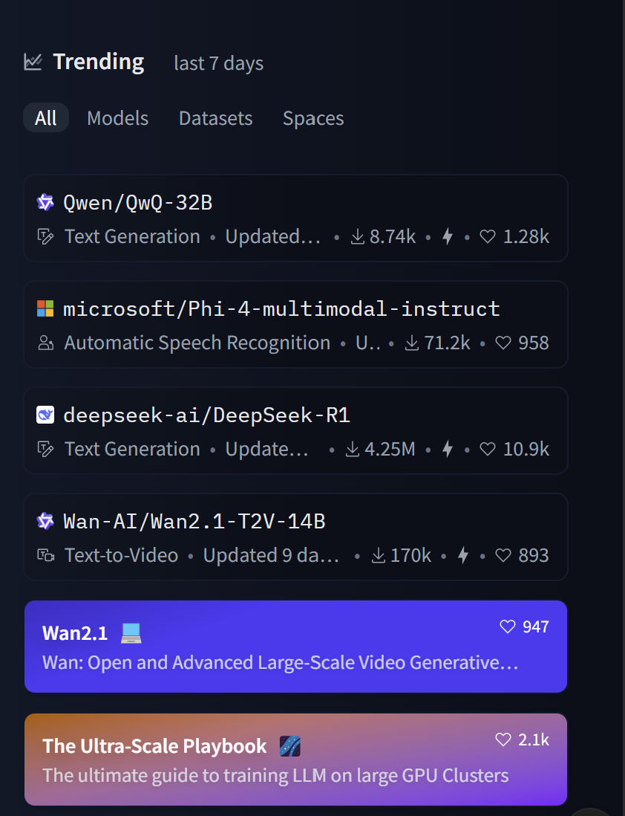
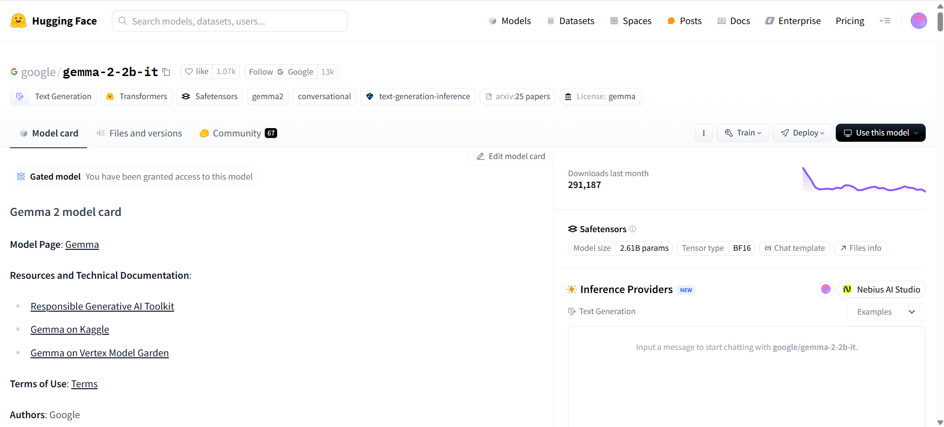
Downloading LLMs
Where to download models: https://huggingface.co/
You can find trending (new) models on the home page
Example of what a model’s Huggingface page looks like

Slide 54
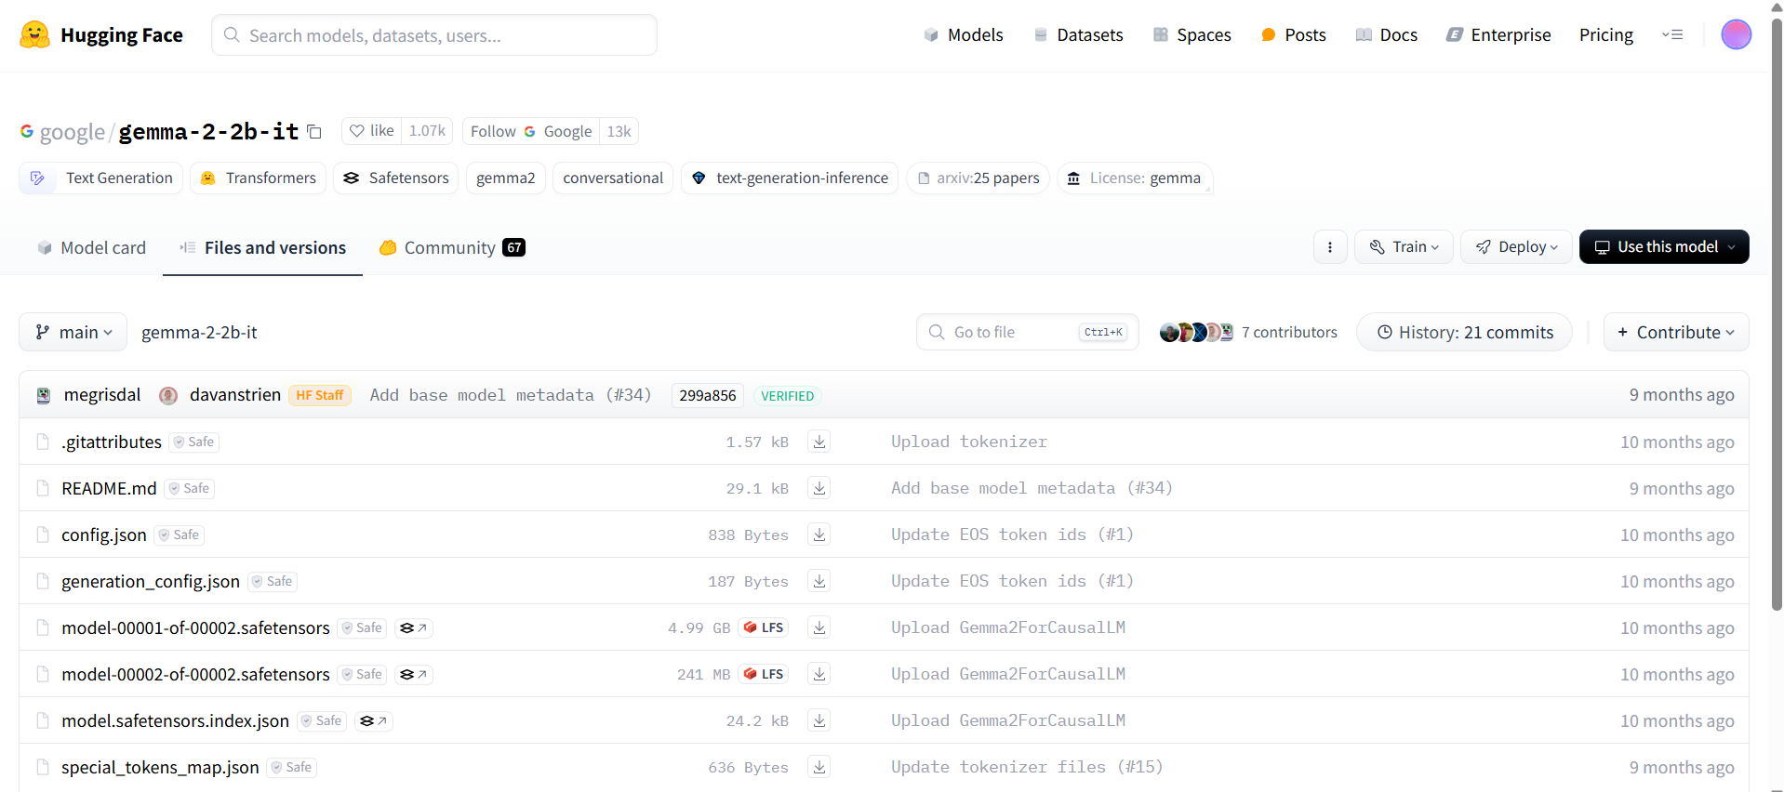
Downloading LLMs (1) – Manual Download

Slide 55
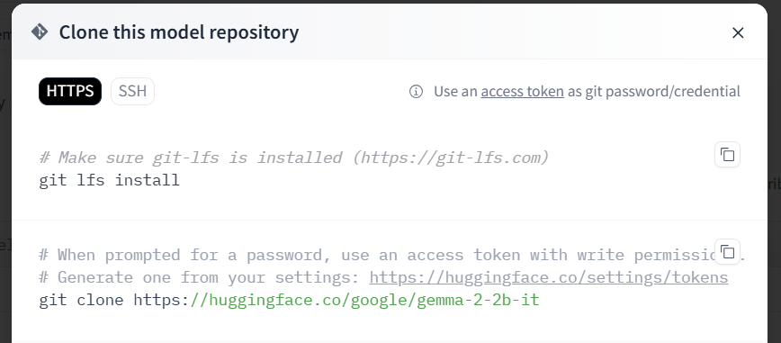
Downloading LLMs (2) - Git

Slide 56
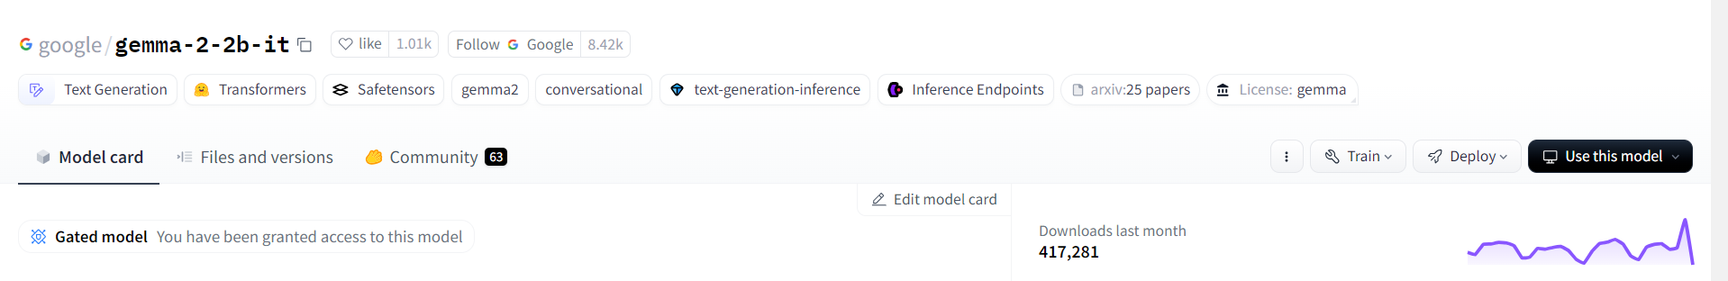
Downloading LLMs (3) – Huggingface/Transformers
google/gemma-2-2b-it
Running models hosted on Huggingface (this will save the models inside the Huggingface library folder):
tokenizer = AutoTokenizer.from_pretrained("google/gemma-2-2b-it", trust_remote_code=True)
model = AutoModelForCausalLM.from_pretrained("google/gemma-2-2b-it", trust_remote_code=True, device_map=0)
Running local/downloaded model:
tokenizer = AutoTokenizer.from_pretrained("/home/sean/Desktop/qlora-main/gemma2-2b-it", trust_remote_code=True)
model = AutoModelForCausalLM.from_pretrained("/home/sean/Desktop/qlora-main/gemma2-2b-it", trust_remote_code=True, device_map=0)

Slide 57
Huggingface Access Tokens
Some models on Huggingface are gated, meaning you need permission to download them
Usually all this entails is accepting their license, some models are gated behind a paywall instead
In such cases, you need to provide your Huggingface account’s access tokens in order to download the model using methods 2 and 3
Manually downloading from the webpage while logged in bypasses the need to provide access tokens

Slide 58
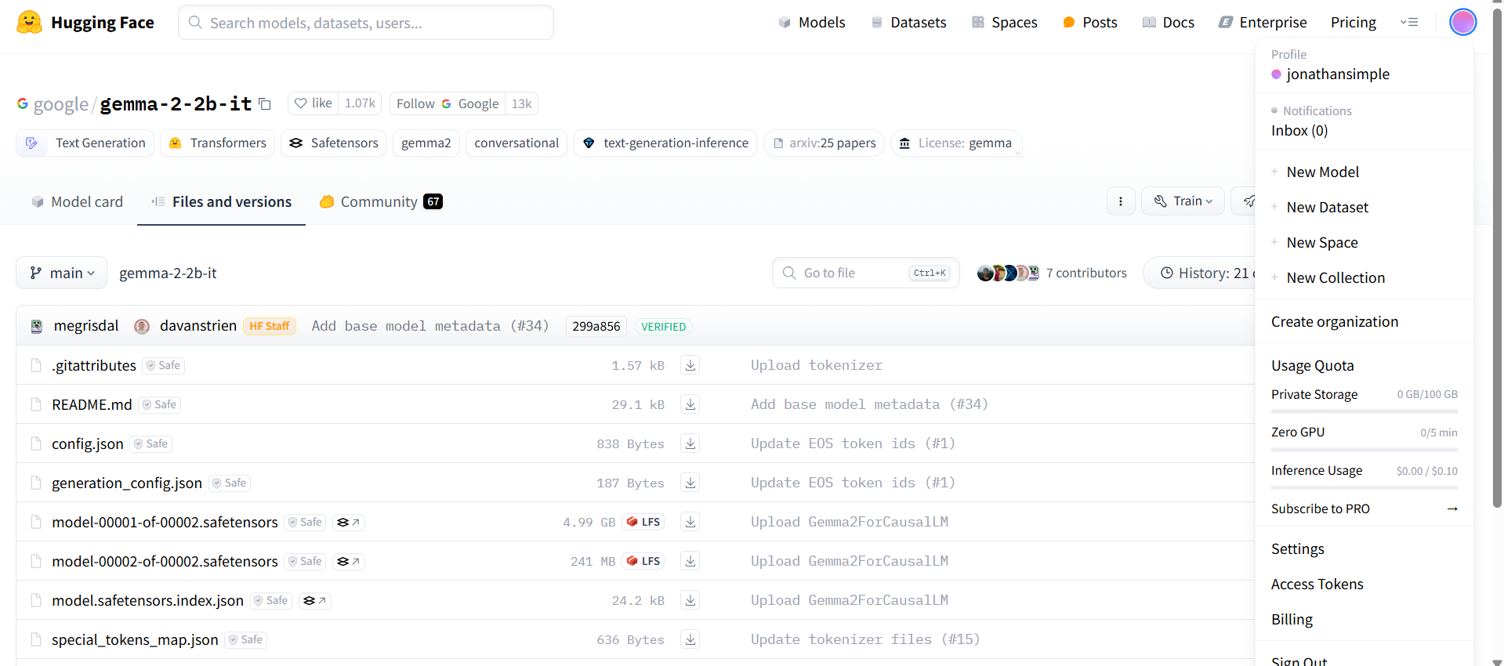
How to Create Your Huggingface Access Tokens
Under account profile, find the “Access Tokens” category (you can also get there via Settings)

Slide 59
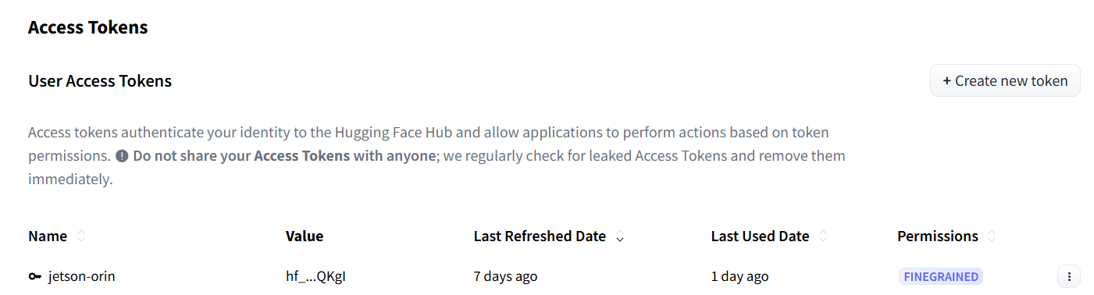
How to Create Your Huggingface Access Tokens
Create your token with the desired read/write privilege and copy it for the next step

Slide 60
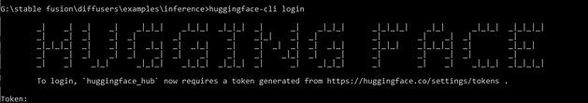
How to Provide Your Huggingface Access Tokens
Method 1: log into huggingface in your conda environment
Install huggingface_hub with command line interface
pip install -U “huggingface_hub[cli]”
Log in using your access token
huggingface-cli login

Slide 61
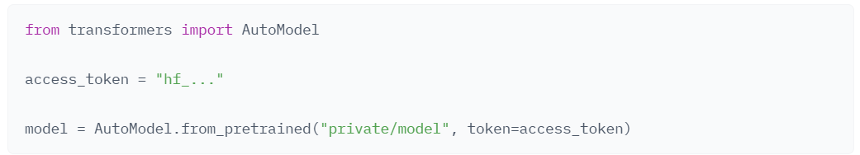
How to Provide Your Huggingface Access Tokens
Method 2: provide your access tokens when you call from_pretrained() [the function that pulls the model]
Notes:
https://huggingface.co/docs/hub/security-tokens

Slide 62
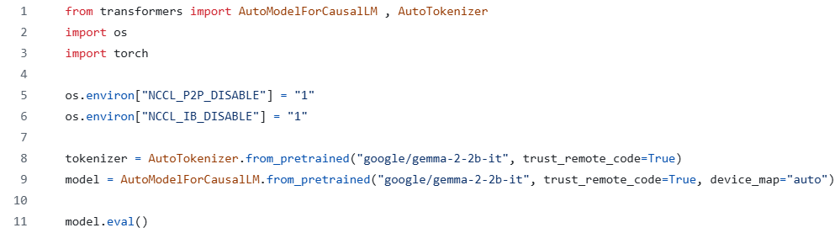
Transformers Example: Imports + Model Loading
If your system doesn’t support P2P GPU communication or InfiniBand (IB), set these environment variables otherwise your program may crash
Replace “google/…” with the path to the folder containing your LLM if you want to load your model + tokenizer from local file
Source code: inference_transformers.py

Slide 63
LLM Deployment Using Transformers

Slide 64
Inferencing with Transformers
Now that we have loaded our model, we can proceed to inferencing
Five main steps:
Generation configuration
Query formatting
Tokenize
Generate/inference
Decode

Slide 65
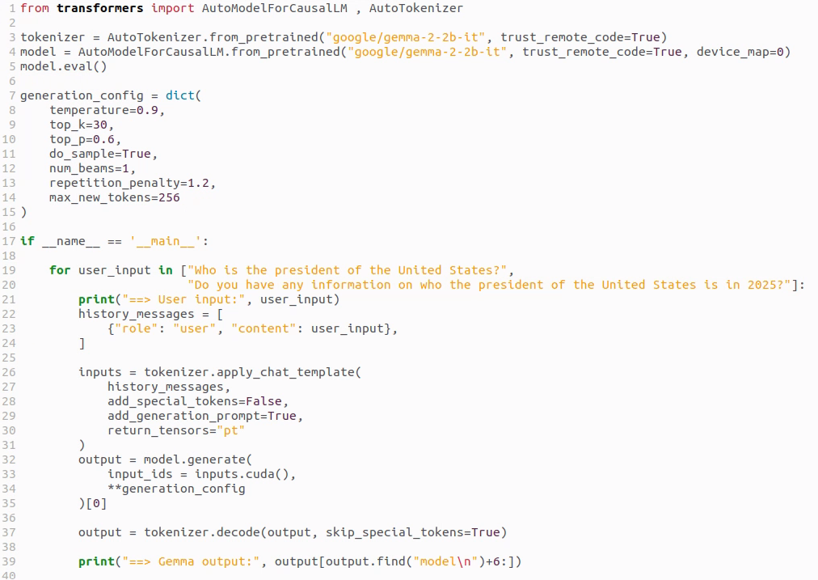
Inference Code Example (modified inference_transformers.py to fit on screen)
1. Set temperature to 0 (or do_sample to False) for deterministic outputs
1. Beam search setting: >1 for less randomness, ==1 for creativity
1. Sets the maximum length of the LLM’s response
2. Generate a new chat session + specify whom (system/user/LLM) this string belongs to
3. Tokenize: convert chat log (string) to tokens
4. Inference step (output is tokens)
5. Convert output tokens to string
Notes:
num_beams controls how many candidate sequences the model keeps track of during beam search decoding.
When to use num_beams
Use beam search (i.e., num_beams > 1) for tasks like:
Summarization
Translation
QA (when deterministic output is better)
When you want higher-quality, less random outputs
Don’t use it when you want:
Randomness/creativity → use do_sample=True instead
If you use num_beams > 1, make sure: do_sample = False
Otherwise the sampling randomness conflicts with beam search logic.

Slide 66
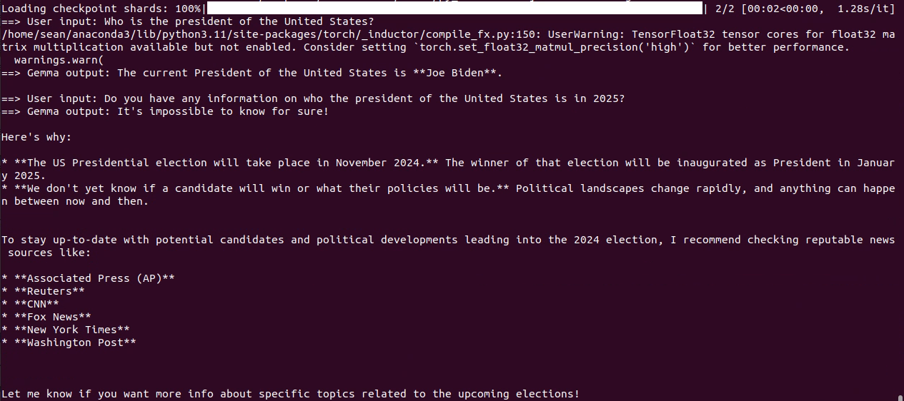
Inference Code Example: Output (inference_transformers.py)
This query exposes the older model’s outdated knowledge base

Slide 67
LLM Deployment Alternatives

Slide 68
LLM Deployment Tools
Feature | Transformers | Ollama | LM Studio
Primary Use | Running, fine-tuning, and deploying LLMs | Local, easy-to-use deployment of LLMs | Local LLMs with GUI-based interaction
User Interface | Python code (CLI/Script-based) | CLI-based, simple for local models | GUI-based, user-friendly for local use
Hardware Requirements | Flexible (depends on model) | Light-weight, works on most systems | Local models (limited by hardware)
Deployment Scale | Small to large-scale (with proper setup) | Small to medium-scale (local use) | Personal or small-scale deployment
Target | Flexibility and ease of use for researchers | Simplicity and accessibility | Simplicity, local deployment
Performance | Slow | Fast | Fast
Out of all the deployment options, transformers is the slowest, transformers is mostly intended for development and not deployment

Slide 69
Ollama
Great tool for hosting LLMs locally
Based on llama.cpp – optimized for speed
Works on Linux, Windows, macOS
Supports a wide variety of models – if you can’t find the model you are looking for, you can import your own model (in GGUF format)
Notes:
Benefits of locally hosting llms

Slide 70
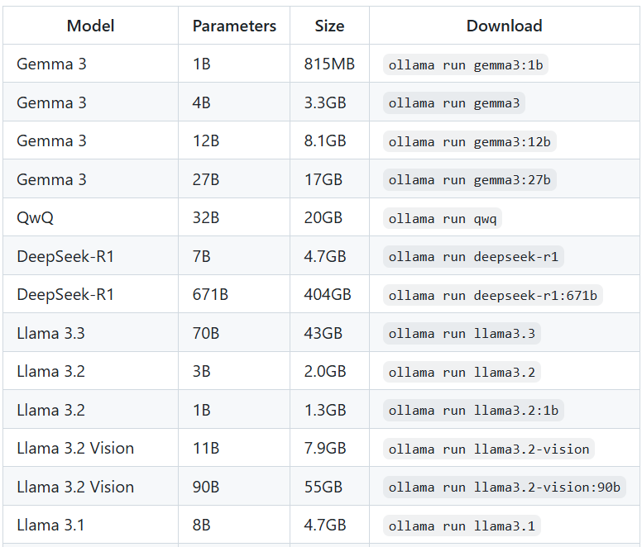
Setting Up Ollama (Linux)
Installation:
curl -fsSL https://ollama.com/install.sh | sh
Downloading a model:
ollama pull gemma3:1b-it-qat
Running a model:
ollama run gemma3:1b-it-qat
Print out all available (downloaded) models
ollama list
A non-exhaustive list of readily available models

Slide 71
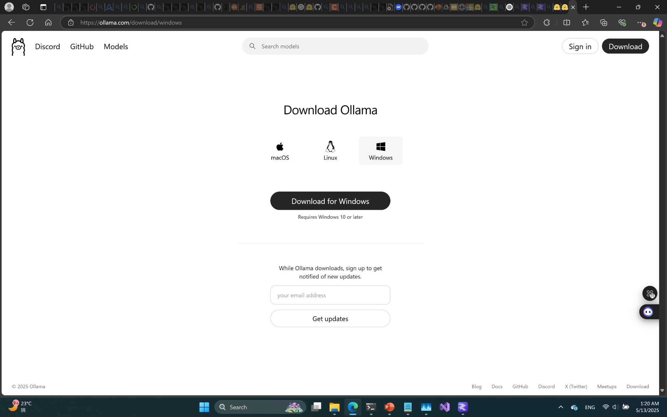
Setting Up Ollama (Windows)
A straightforward installer is available for Windows (simply download and run)

Slide 72
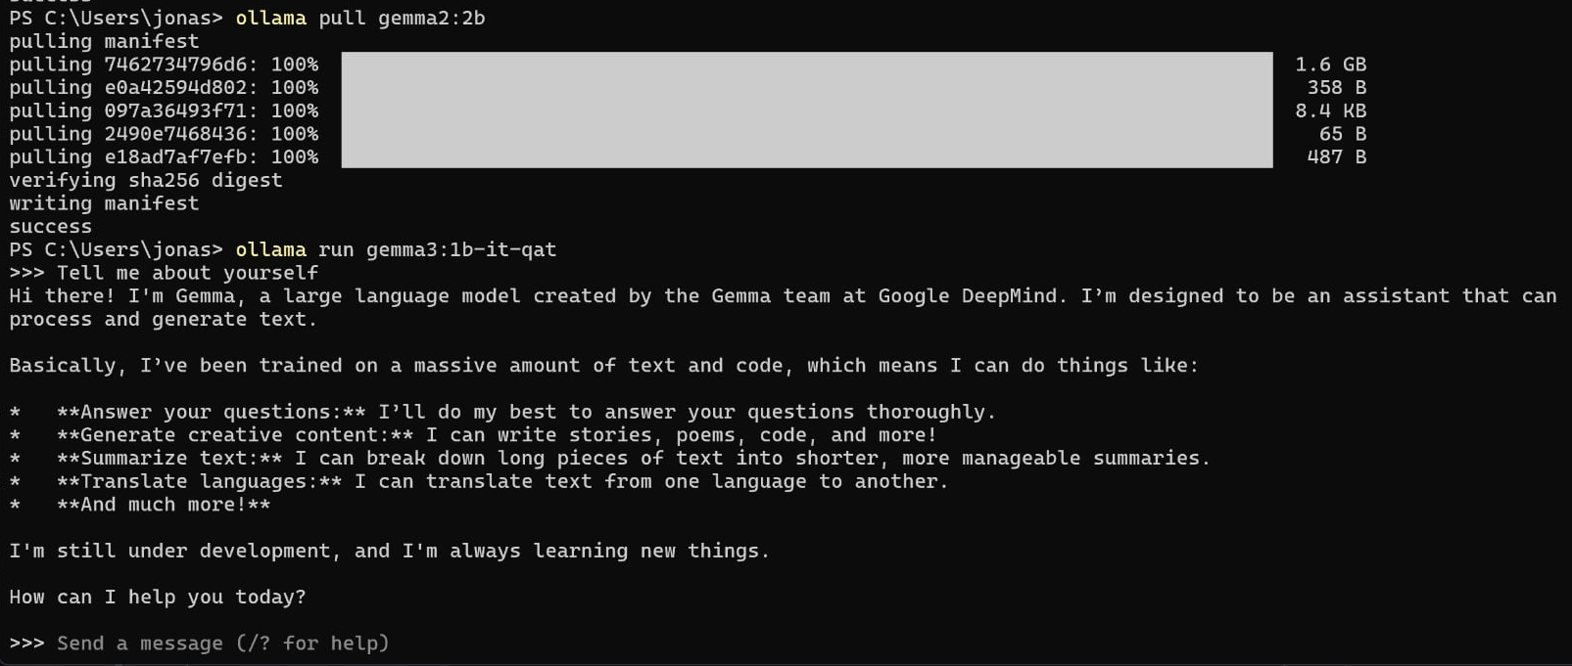
Running Ollama as a Chatbot on Command Line
Use the command: ollama run gemma3:1b-it-qat

Slide 73
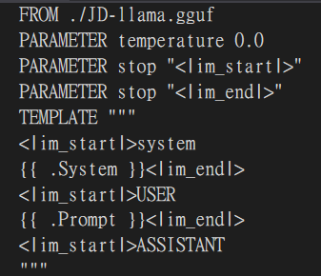
Working With Modelfiles in Ollama (Linux)
With Modelfiles, you can have greater control over the LLM hosted on Ollama
Running your own model:
>>> ollama create mymodel –f modelfile.txt
>>> ollama run mymodel
Quantizing a model:
>>> ollama create --quantize q4_K_M mymodel_q –f modelfile.txt
>>> ollama run mymodel_q
An example of what a Modelfile would look like. The FROM line is mandatory (path to the model)

Slide 74
Using Ollama as a Server
A command line chatbot isn’t very useful, but Ollama can be used as a server to handle query requests
How do we set up an Ollama server?
On your machine’s bootup, Ollama should already be running by default, if not, run ollama serve
What models are available?
All of the model listed when you call ollama list
What is the server’s address?
By default, the Ollama server is posted on http://localhost:11434/v1

Slide 75

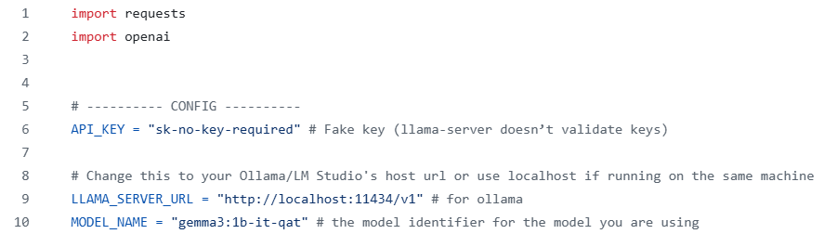
Sending a Query to Your Ollama Server (inference_ollama.py)
List of available LLMs
The model name should match that shown in ollama list

Slide 76
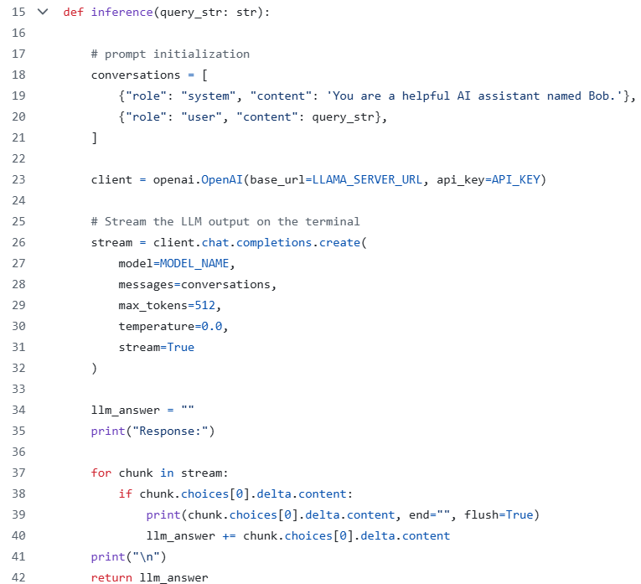
Sending a Query to Your Ollama Server (inference_ollama.py)
Label your query and add any system prompts you wish
Create a client pointing to your Ollama server
The chat completion is where you specify which model you wish to use (notice how you are not explicitly calling tokenizers now, it’s all being done beneath the hood)
Because we set stream=True, the LLM tokens will be streamed to the terminal in real time

Slide 77
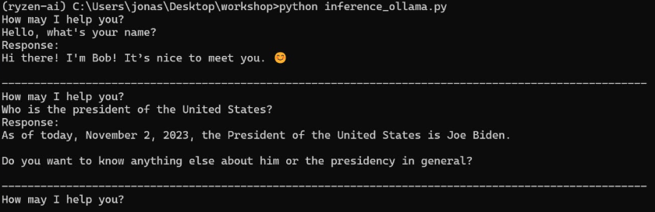
Using Ollama as a Server (inference_ollama.py)

Slide 78
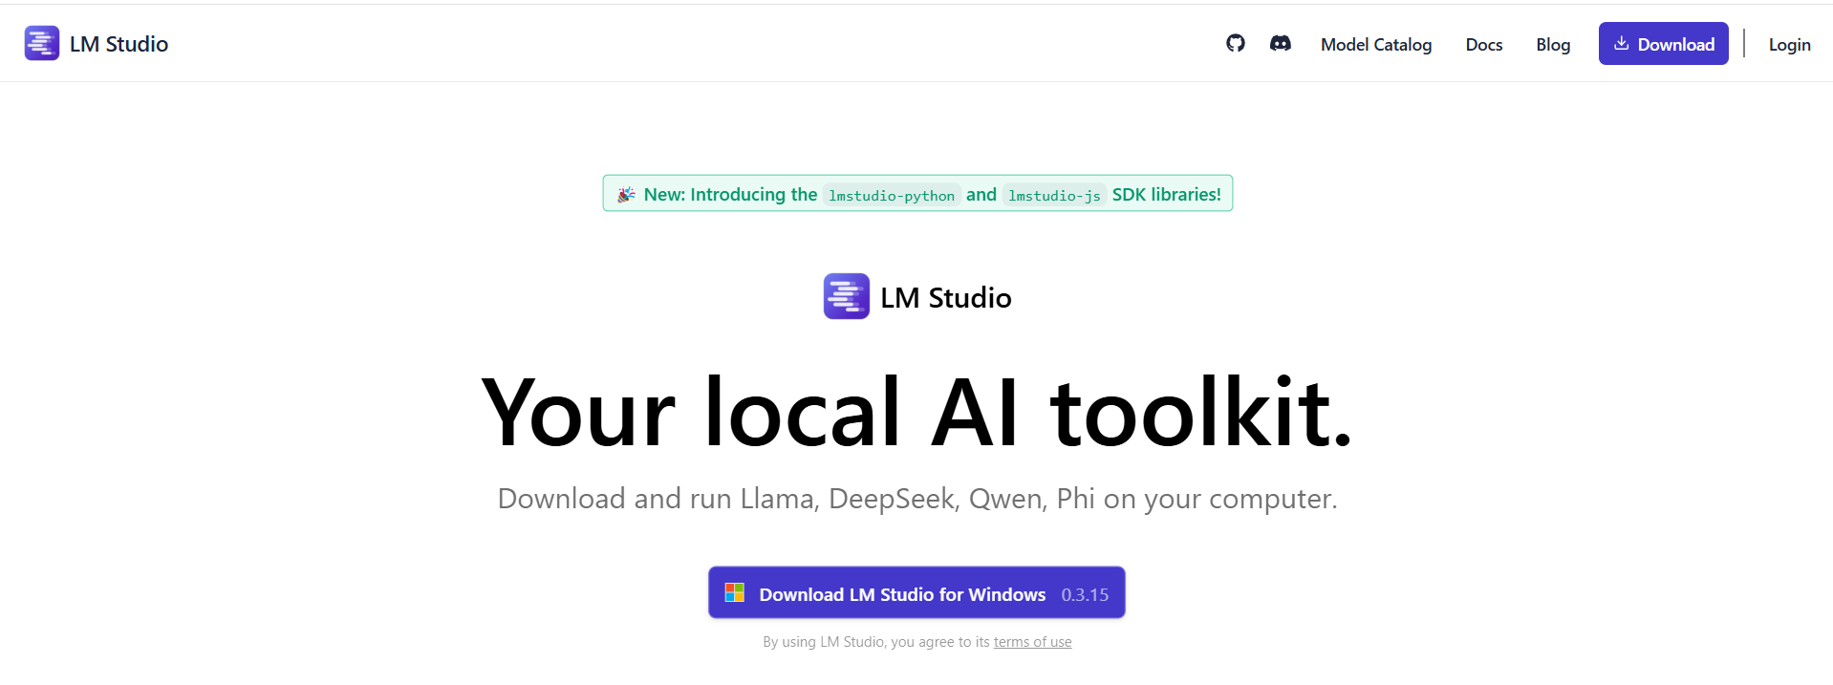
LM Studio (Windows)
LM Studio is another tool for deploying LLMs that comes with a clean GUI
LM Studio also has a lot of interesting stats readily available (token/s, total tokens, token generation termination cause)
Great for beginners

Slide 79
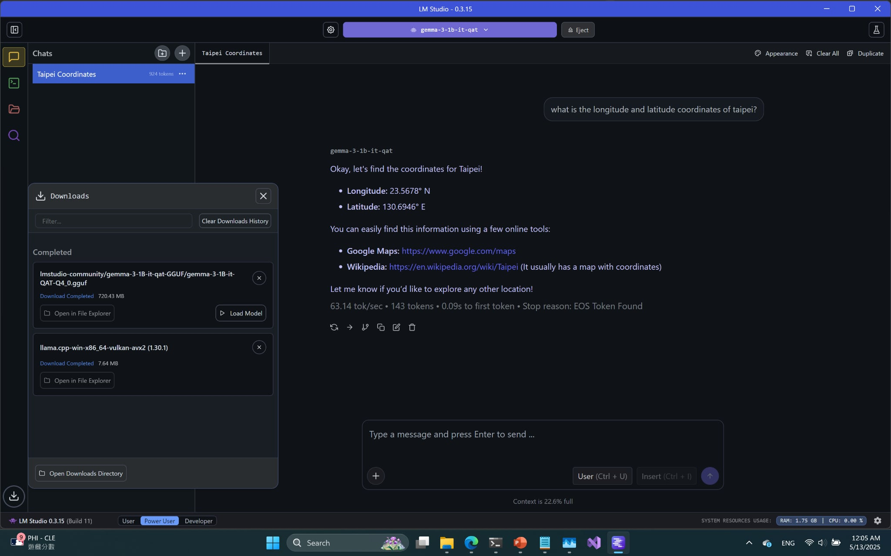
Running LM Studio as a Chatbot (Windows)
Select your desired LLM from the ones you downloaded
Performance metrics

Slide 80
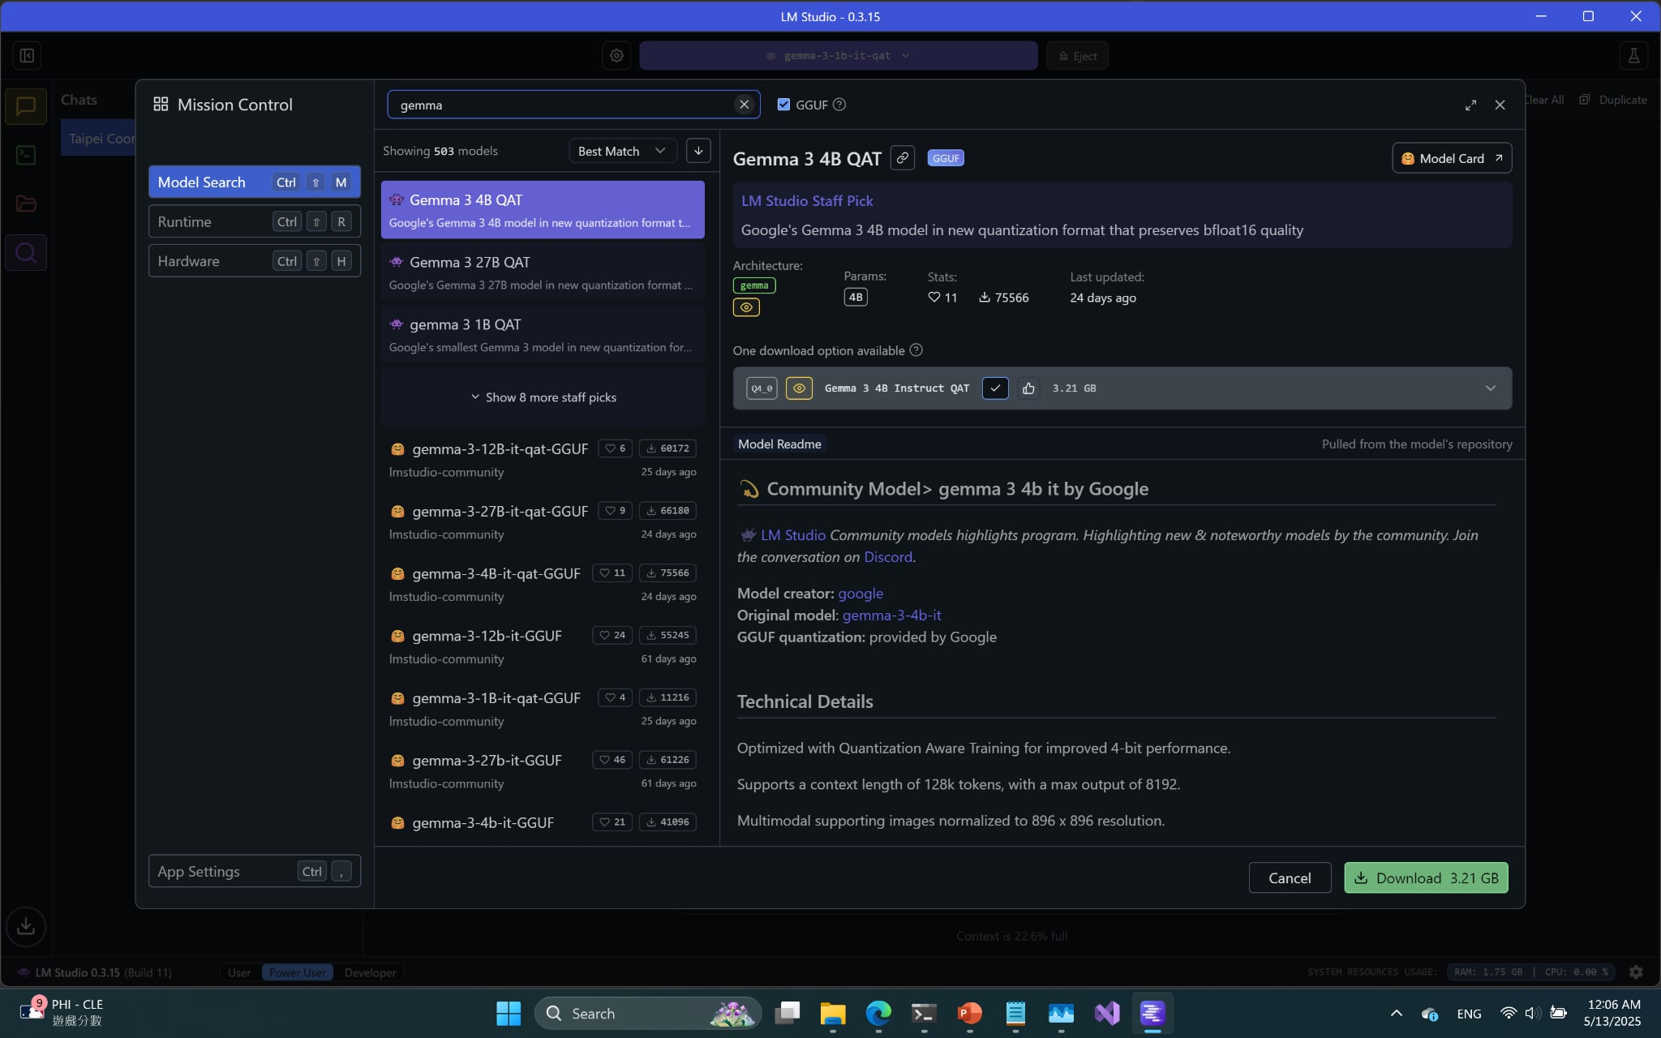
Downloading Models on LM Studio (Windows)
LM Studio can pull models off Hugging Face through the built in search sidebar

Slide 81
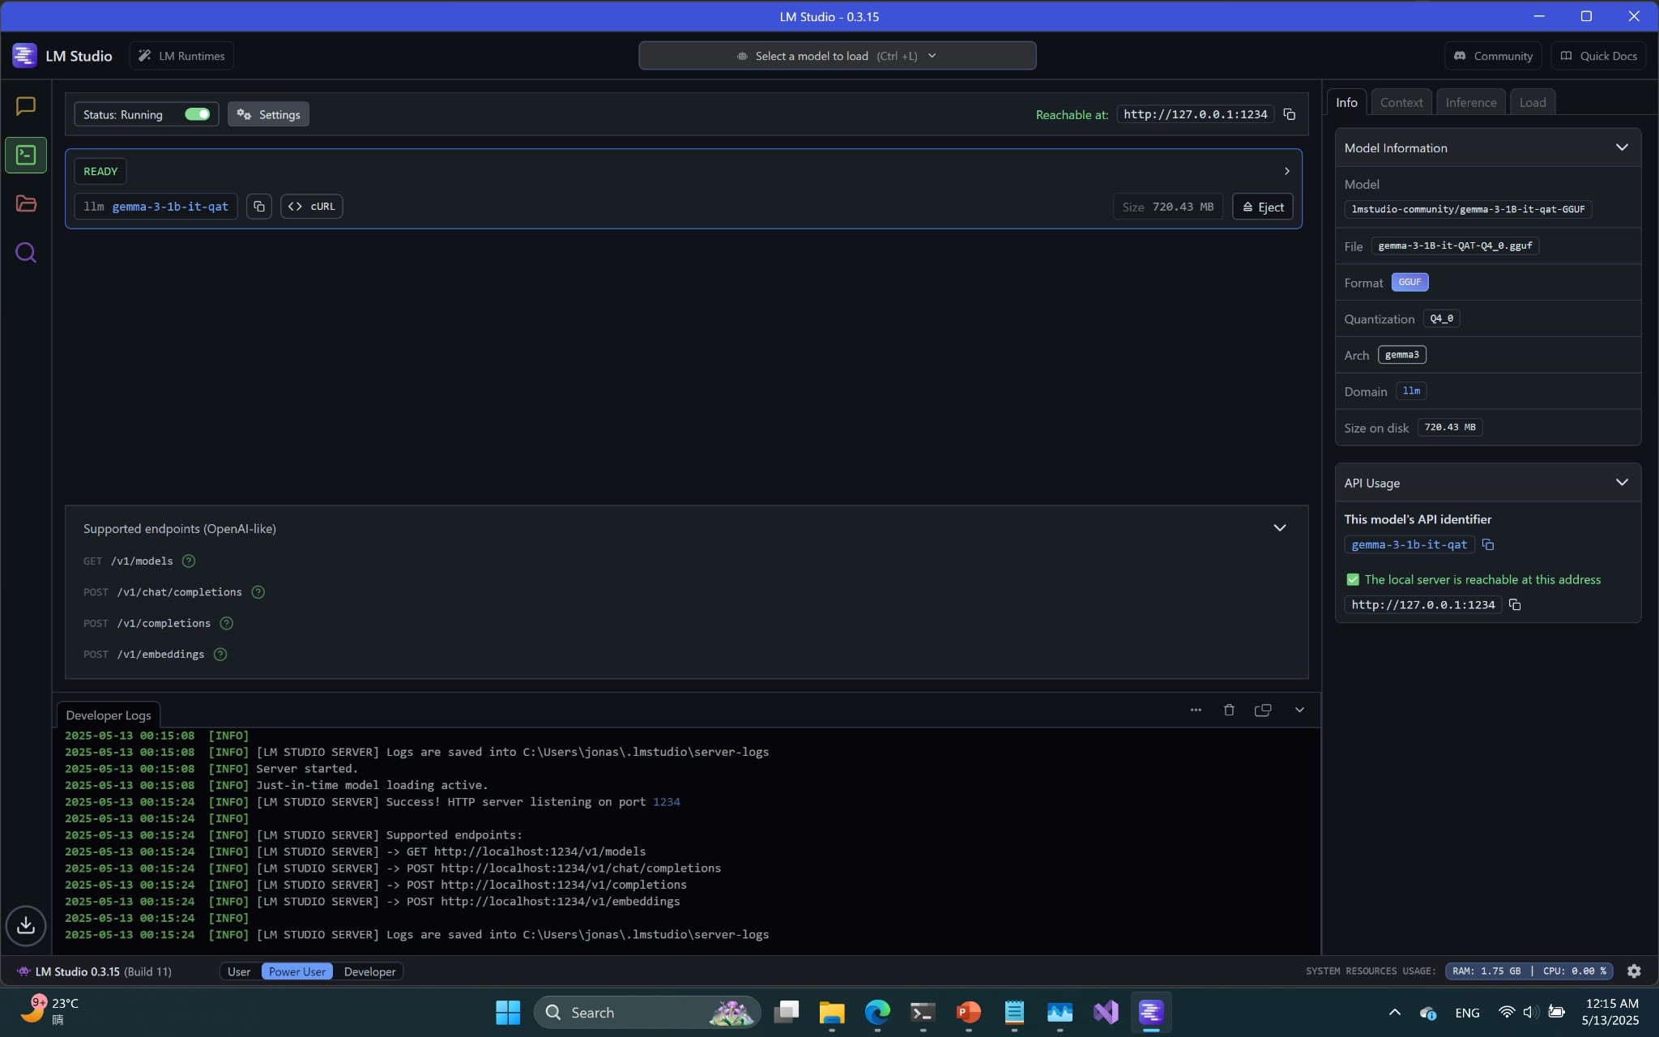
Using LM Studio to Host a Server
Go to the developer tab
A list of downloaded models will appear here

Slide 82
Using LM Studio to Host a Server
Toggle the start server status to start your server (different from Ollama)
Developer Logs and API usage has useful information for setup and debugging

Slide 83
Using LM Studio to Host a Server
Very similar to Ollama (in fact, code is identical, just change server address and model name)
What is the server’s address and model handle?
Check the API Usage sidebar for the server url and the model handle

Slide 84
Fine Tuning with LoRA

Slide 85
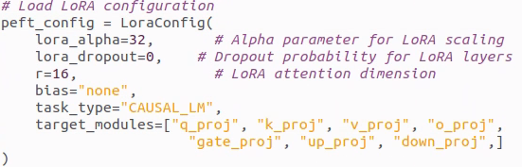
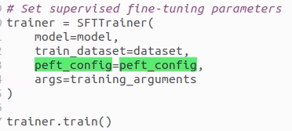
How to Set Up LoRA Fine Tuning
You’ll need to install the peft library
You can tune your LoRA hyperparameters using peft’s LoraConfig()
During training, you pass this config to the trainer

Slide 86
LoRA Hyperparameters
For those just getting started with LoRA, focus on the r (rank) and alpha parameters
If you run into CUDA OOM (out of memory) problems and you can’t reduce your batch size or max input length any further, you can try reducing the rank
When starting out, it is recommended to maintain a 1:2 ratio between rank and alpha

Slide 87
Other Hyperparameters
The trainer used for this demo comes from transformers’ trl library (specifically SFTTrainer and SFTConfig)
Here are some noteworthy parameters to tune while training your model:
max_seq_length: how many tokens your model can take in at once, affects your LLM’s ability to handle long inputs; drastically affects VRAM usage
per_device_train_batch_size: batch size, adjust this based on your VRAM
save_strategy: how often you save checkpoints
num_train_epochs: how many epochs to train for (you can also opt to use steps as a unit instead of epoch)
learning_rate
bf16: whether to train in bf16
logging_steps: how often you log training statistics

Slide 88
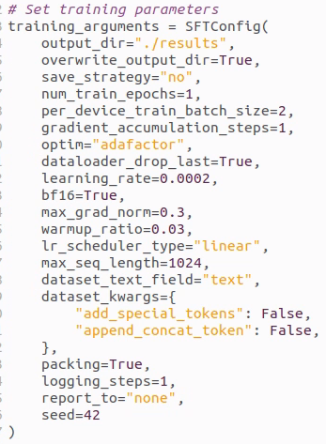
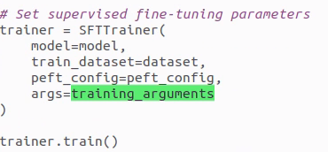
Example SFTConfig
See gemma_function_calling_finetune.py for a short example that you can run with a custom function calling dataset inside the ./dataset folder

Slide 89
Inferencing - Function Calling

Slide 90
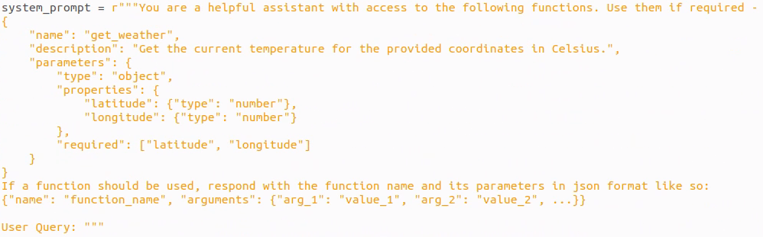

Function Calling Example: Function Declaration
The description fields are important for informing the LLM on when a function should be used
Sample output, the model provides the coordinates to Taiwan using its existing knowledge

Slide 91
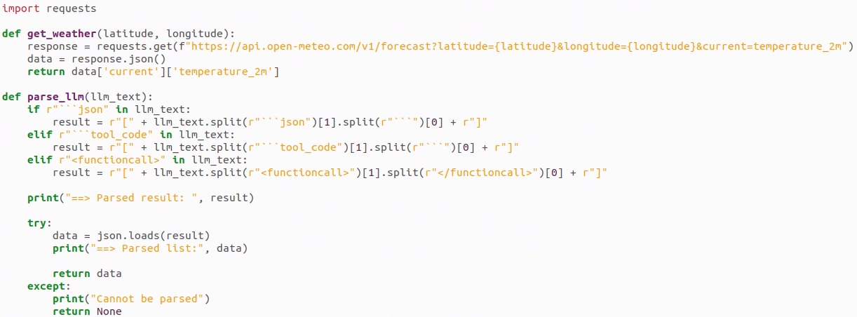
Function Calling Example: API Integration
API call
temperature_2m is the temperature 2 meters above ground
Handle LLM’s structured output
Parse LLM output (string) into json

Slide 92
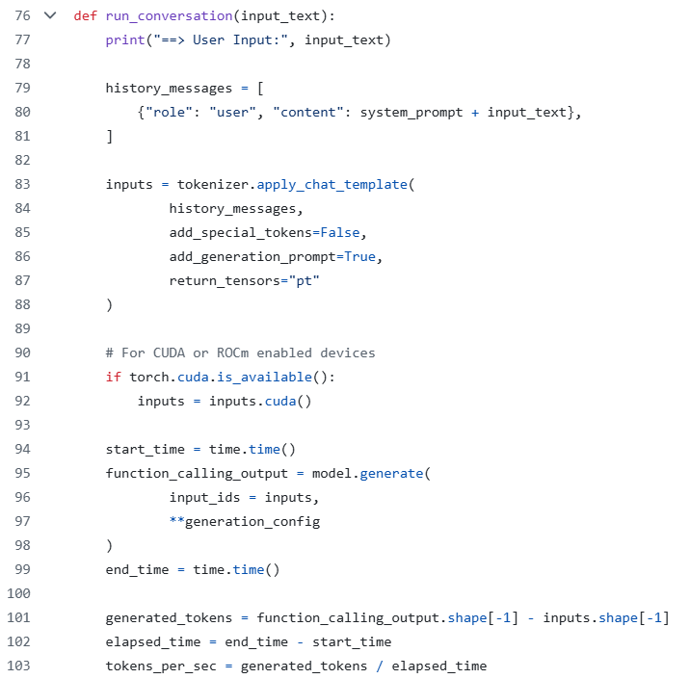

Function Calling Example: Inference Step (function_calling_transformers.py)
Format user query and add function list to query
Tokenize string
Inference
Decode
Parse LLM output as json and call API

Slide 93

Function Calling Example: Inference Step (function_calling_ollama.py)
Format user query and add function list to query
Config client
Send request to server and stream output
Parse LLM output as json and call the correct function using function name and use the correct function input using arguments
Call API

Slide 94

Function Calling Example: Output (function_calling_ollama.py)

Slide 95
RAG Using Ollama and LM Studio

Slide 96
Problem Rehash
Why RAG?
Some models have outdated information, but we don't want to find tune the model
Difference between RAG and normal inference:
Additional context for generation is provided (normally you only have the query)
As a result, your prompt will look different
Here is a very simple RAG prompt:
Context: Donald Trump won the 2024 presidential election and remains president in 2025. Most new models can perform function calling out-of-the-box.
Question: Who is the president of the United States in 2025?
Answer:

Slide 97

Building a Vector Store for Retrieving Relevant Context (rag_query_ollama.py)
One of many examples of building a vector store using FAISS

Slide 98

Generating a Response using LM Studio (rag_query_ollama.py)
Very similar to the Ollama client code, the only difference here is that the system prompt and user prompt have been modified to be more RAG friendly.

Slide 99


Putting Everything Together (rag_query_ollama.py)
Find the top 2 documents that most closely relate to the query
Concat the retrieved contexts for the RAG prompt
End-to-end function call

Slide 100

RAG Using Ollama and LM Studio (rag_query_ollama.py)

Slide 101
Conclusion
In this course, we discussed how to:
Perform function calling using LLMs
Improve a LLM's factual accuracy without fine tuning using RAG
To do this, we covered:
What are LLMs, tokenizers, and function calling
How to craft prompts to maximize a LLM's potential
How to inference using a variety of platforms (transformers, Ollama, LM studio)
How to fine tune a LLM

